Slide 1
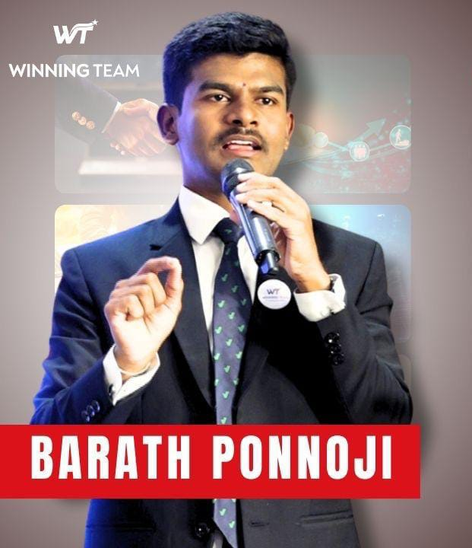
SERVER OF
WINNING TEAM

Slide 2

SERVING IS AN ATTITUDE
ONLY DONE WITH A GREAT HEART
NEED TO LEARN FROM TEAM WINNING TEAM
AND AMIT SIR SANKAT MOCHAK

Slide 3
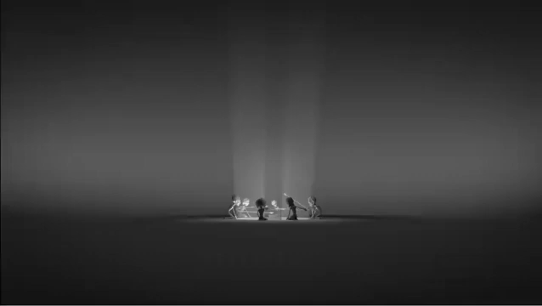
WHY SERVING IS IMPORTANT

Slide 4
HERE WE SERVE WINNING TEAM
IF WE SERVE IN OUR LOCATION / WINNING TEAM WILL SERVE US EVERY WHERE
I LEARNT FROM OUR GREAT UPLINE INDEERBER SINGH SIR
SERVING OTHERS IN HYDERABAD FOR GROWING OTHERS BUSINESS
WE STARTED SERVING OTHERS OF OTHER LOS FOR PLANS, AGRI DEMOS,CEO’S, ETC

Slide 5
SUCCESS IS NOT ABOUT WHAT YOU HAVE,
BUT WHAT YOU GIVE
WINNING TEAM’S SIGNATURE STATEMENT
जनाब पहले आप

